Slide 1
Backpropagation
Dr. Gahangir Hossain
Texas A&M University-Kingsville
Slides from: Ali Ghodsi and Ion Stoica, UC Berkeley

Slide 2
Perceptron
Invented by Frank Rosenblatt (1957): simplified mathematical model of how the neurons in our brains operate
From: http://www.andreykurenkov.com/writing/ai/a-brief-history-of-neural-nets-and-deep-learning/

Slide 3
Perceptron
Could implement AND, OR, but not XOR
From: http://www.andreykurenkov.com/writing/ai/a-brief-history-of-neural-nets-and-deep-learning/

Slide 4
Hidden layers
Hidden layers can find features within the data and allow following layers to operate on those features
Can implement XOR
From: http://www.andreykurenkov.com/writing/ai/a-brief-history-of-neural-nets-and-deep-learning/

Slide 5
Learning: Backpropagation
From: http://www.andreykurenkov.com/writing/ai/a-brief-history-of-neural-nets-and-deep-learning/

Slide 6
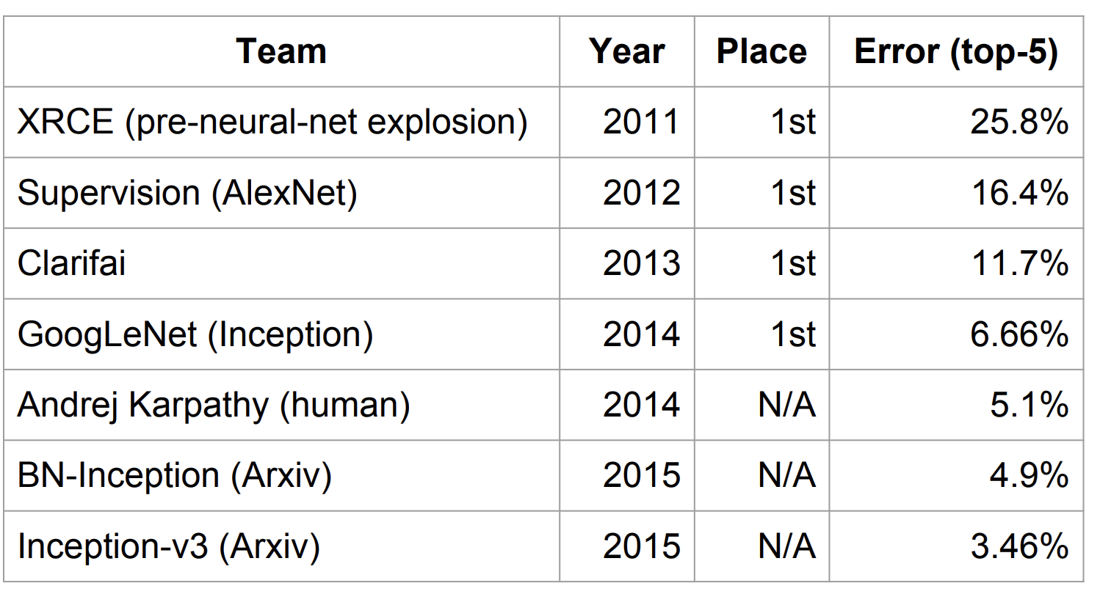
Context (circa 2015)
Deep learning already claiming big successes
Imagenet
challenge
classification
task
From: http://www.wsdm-conference.org/2016/slides/WSDM2016-Jeff-Dean.pdfz

Slide 7
Context (circa 2015)
Deep learning already claiming big successes
Number of developers/researchers exploding
A “zoo” of tools and libraries, some of questionable quality…

Slide 8
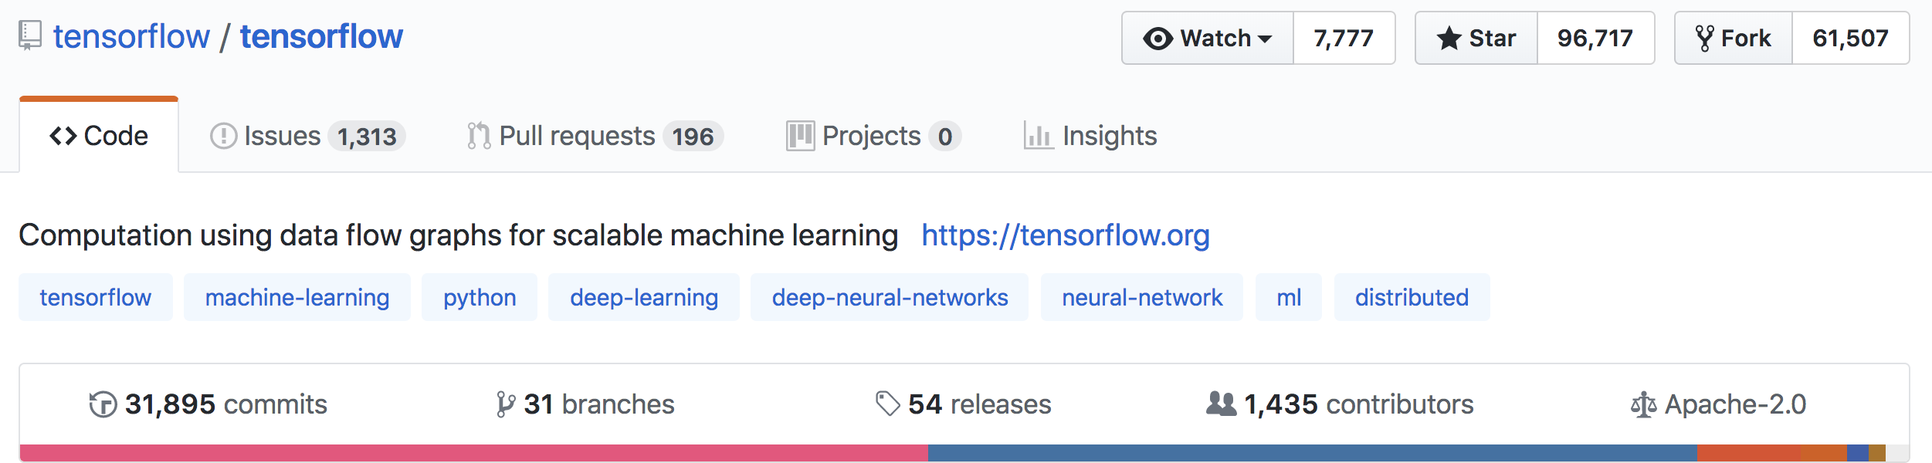
What is TensorFlow?
Open source library for numerical computation using data flow graphs
Developed by Google Brain Team to conduct machine learning research
Based on DisBelief used internally at Google since 2011
“TensorFlow is an interface for expressing machine learning algorithms, and an implementation for executing such algorithms”

Slide 9
What is TensorFlow
Key idea: express a numeric computation as a graph
Graph nodes are operations with any number of inputs and outputs
Graph edges are tensors which flow between nodes

Slide 10
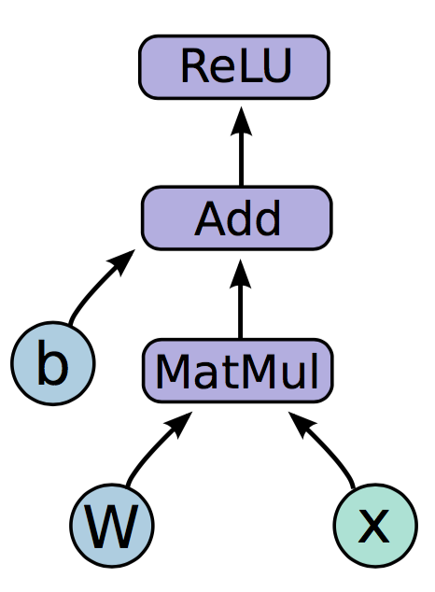
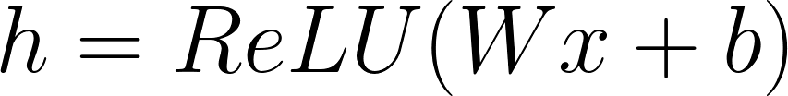
Programming model
Notes:
Neural network with one hidden layer
The function we are computing is on the left. Relu is an activation function that takes the max of 0 and your input, applies a nonlinearity to your network.
The graph on the right is how this function would look like in a tensorflow graph.
Let us break down the nodes in the graph into three types

Slide 11
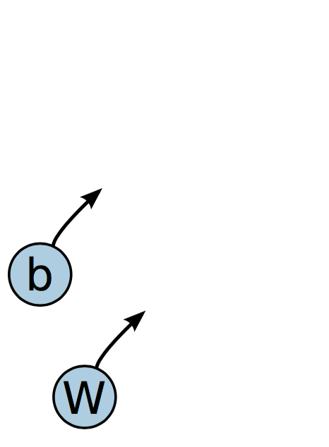
Programming model
Variables are stateful nodes which output their current value. State is retained across multiple executions of a graph
(mostly parameters)
Notes:
We have two variables in this graph, the bias and W matrix.
What we mean by saying that variables are stateful is that they retain their current value over multiple executions, and it’s easy to restore saved values to variables.
Variables have a number of other useful features. They can be saved to disk during and after training, and gradient updates will by default apply over all the variables in your graph
Variables are still operations (nodes = operations!). When you run a variable you get the value of its state.
The variables in your graph are going to be your parameters

Slide 12
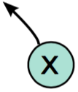
Programming model
Placeholders are nodes whose value is fed in at execution time
(inputs, labels, …)
Notes:
The second important node type is placeholders. If you have inputs into your network that depend on some external data, you want to be able to build your graph without depending on any real values yet, as those are passed in at run time.
Placeholders, unlike variables that have initial assignment, expect as arguments a data type and a shape of a tensor.
Inputs, labels

Slide 13
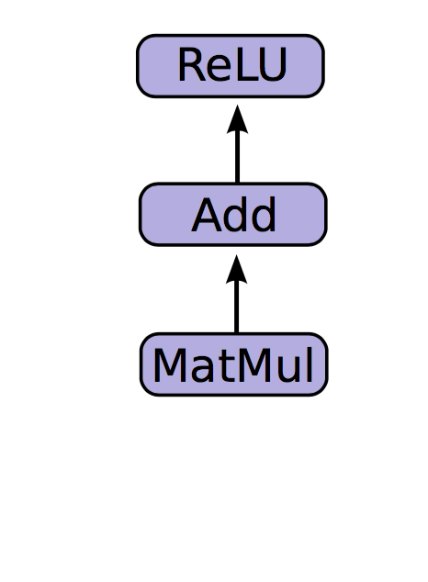
Programming model
Mathematical operations:
MatMul: Multiply two matrices
Add: Add elementwise
ReLU: Activate with elementwise rectified linear function
0, x <= 0
ReLu(x) =
x, x > 0
Notes:
The other nodes are mathematical operations that you are familiar with. Matmul, addition, and relu are all operations in your graph that combine your inputs and parameters to produce new nodes.

Slide 14
Code
import tensorflow as tf b = tf.Variable(tf.zeros((100,))) W = tf.Variable(tf.random_uniform((784, 100), -1, 1)) x = tf.placeholder(tf.float32, (1, 784))
h = tf.nn.relu(tf.matmul(x, W) + b)

Slide 15
Running the graph
Deploy graph with a session: a binding to a particular execution context (e.g. CPU, GPU)
CPU
GPU

Slide 16
End-to-end
So far:
Built a graph using variables and placeholders
Deploy the graph onto a session, i.e., execution environment
Next: train model
Define loss function
Compute gradients

Slide 17
Defining loss
Use placeholder for labels
Build loss node using labels and prediction
prediction = tf.nn.softmax(...) #Output of neural network
label = tf.placeholder(tf.float32, [100, 10])
cross_entropy = -tf.reduce_sum(label * tf.log(prediction), axis=1)

Slide 18
Gradient computation: Backpropagation
train_step = tf.train.GradientDescentOptimizer(0.5).minimize(cross_entropy)
tf.train.GradientDescentOptimizer is an Optimizer object
tf.train.GradientDescentOptimizer(lr).minimize(cross_entropy) adds optimization operation to computation graph
TensorFlow graph nodes have attached gradient operations
Gradient with respect to parameters computed with backpropagation … automatically

Slide 19
Design Principles
Dataflow graphs of primitive operators
Deferred execution (two phases)
Define program i.e., symbolic dataflow graph w/ placeholders
Executes optimized version of program on set of available devices
Common abstraction for heterogeneous accelerators
Issue a kernel for execution
Allocate memory for inputs and outputs
Transfer buffers to and from host memory

Slide 20
Dynamic Flow Control
Problem: support ML algos that contain conditional and iterative control flow, e.g.
Recurrent Neural Networks (RNNs)
Long-Short Term Memory (LSTM)
Solution: Add conditional (if statement) and iterative (while loop) programming constructs

Slide 21
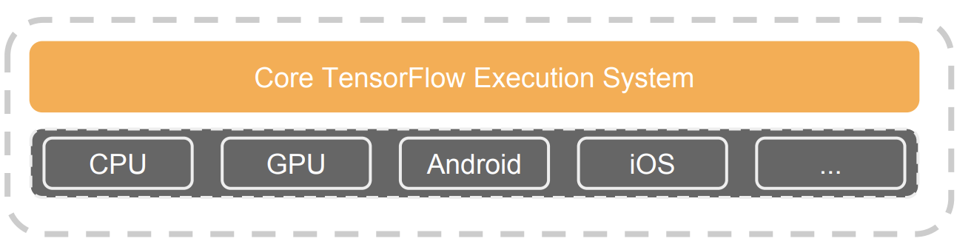
TensorFlow high-level architecture
Core in C++
Very low overhead
Different front ends for specifying/driving the computation
Python and C++ today, easy to add more
From: http://www.wsdm-conference.org/2016/slides/WSDM2016-Jeff-Dean.pdf

Slide 22
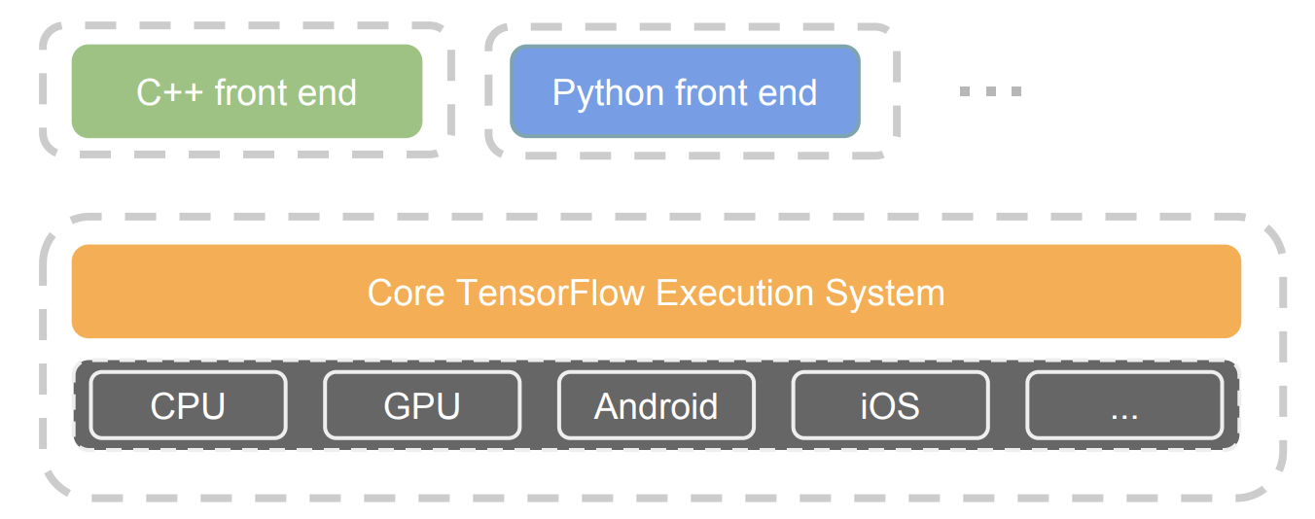
TensorFlow architecture
Core in C++
Very low overhead
Different front ends for specifying/driving the computation
Python and C++ today, easy to add more
From: http://www.wsdm-conference.org/2016/slides/WSDM2016-Jeff-Dean.pdf

Slide 23
Detailed architecture
From: https://www.tensorflow.org/extend/architecture

Slide 24
Key components
Similar to MapReduce, Apache Hadoop, Apache Spark, …
From: https://www.tensorflow.org/extend/architecture

Slide 25
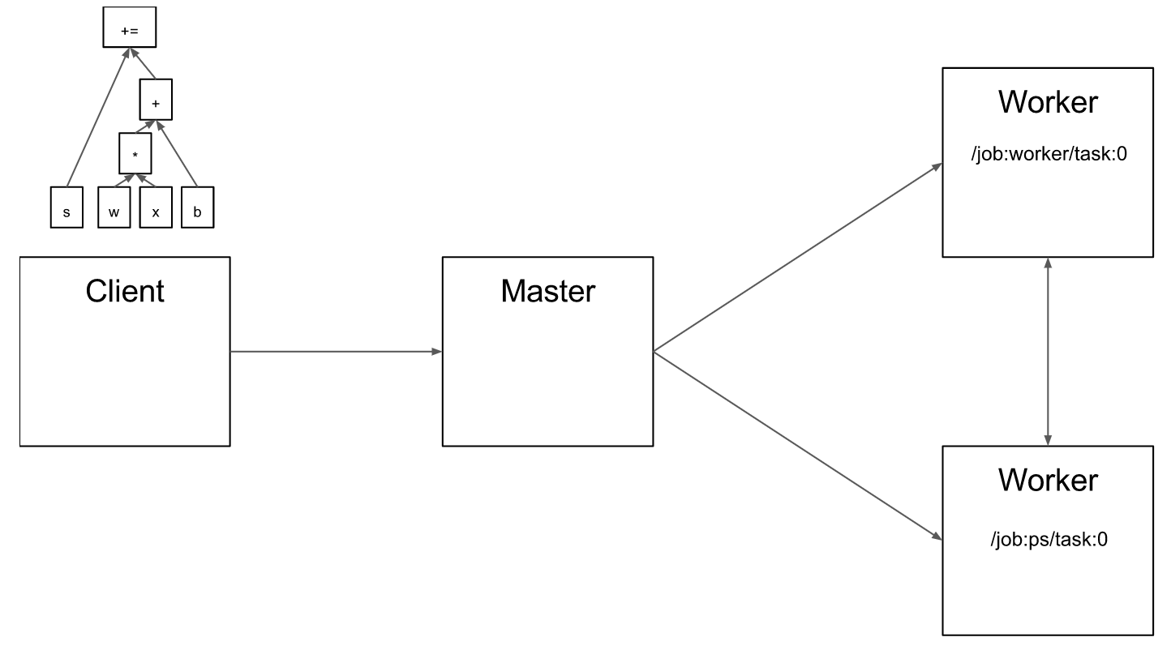
Client
From: https://www.tensorflow.org/extend/architecture

Slide 26
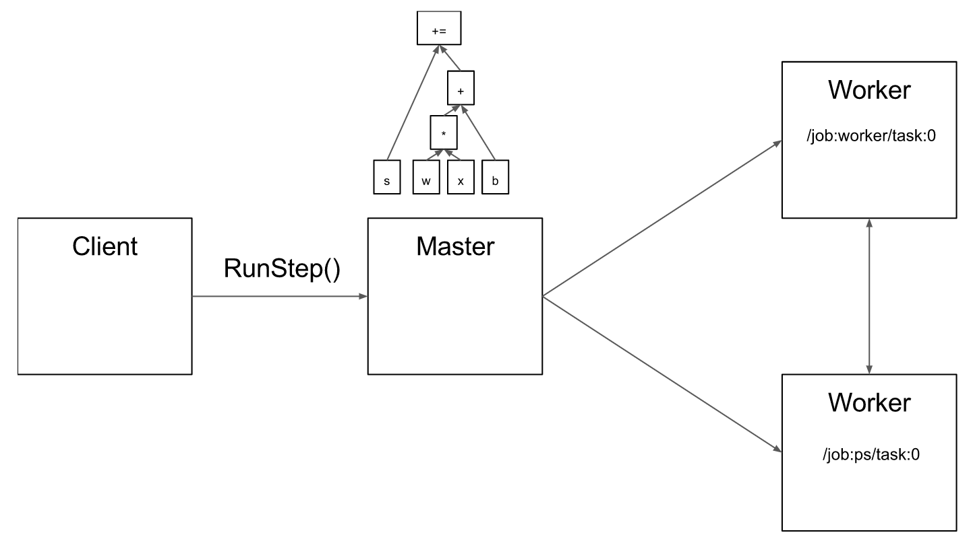
Master
From: https://www.tensorflow.org/extend/architecture

Slide 27
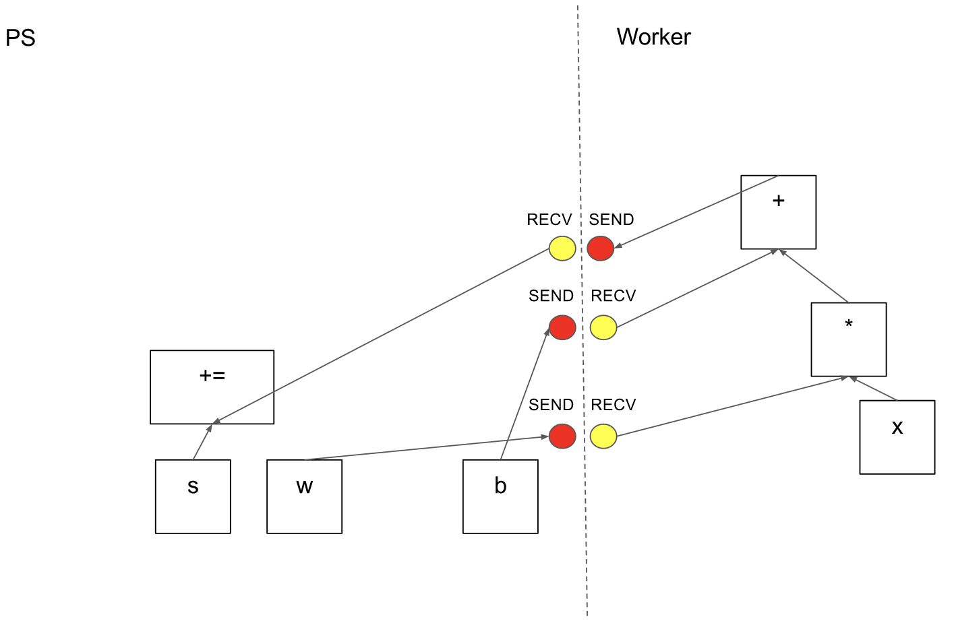
Computation graph partition
From: https://www.tensorflow.org/extend/architecture

Slide 28
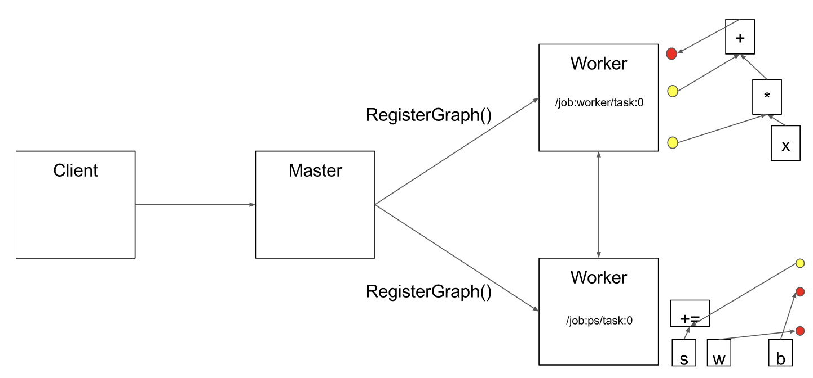
Computation graph partition
From: https://www.tensorflow.org/extend/architecture

Slide 29
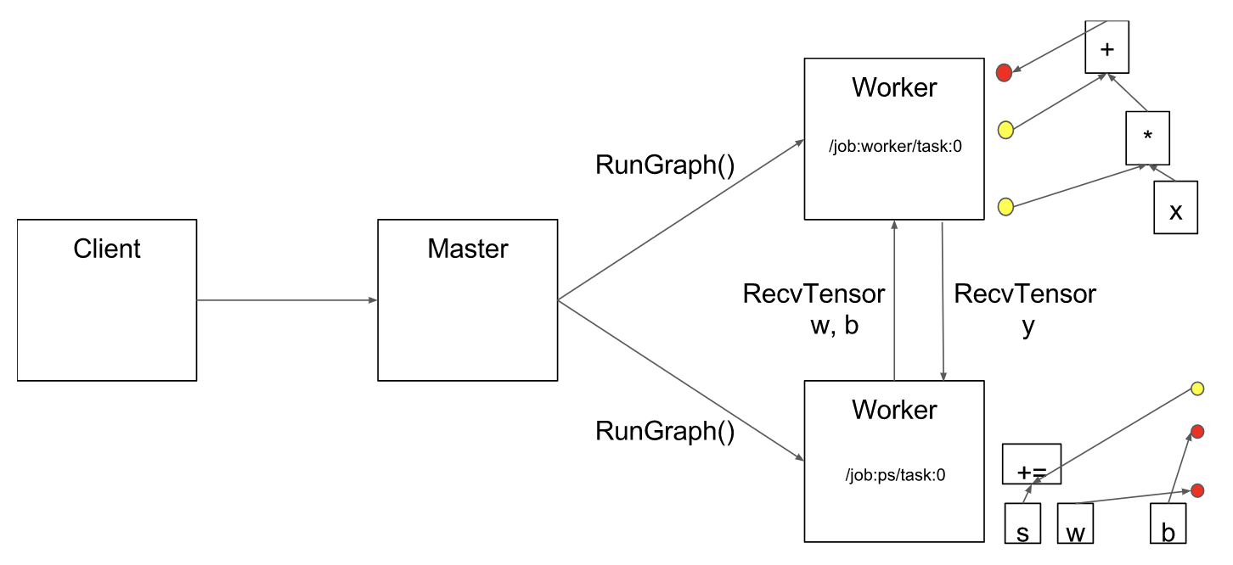
Execution
From: https://www.tensorflow.org/extend/architecture

Slide 30
Fault Tolerance
Assumptions:
Fine grain operations: “It is unlikely that tasks will fail so often that individual operations need fault tolerance” ;-)
“Many learning algorithms do not require strong consistency”
Solution: user-level checkpointing (provides 2 ops)
save(): writes one or more tensors to a checkpoint file
restore(): reads one or more tensors from a checkpoint file

Slide 31
Discussion
Eager vs. deferred (lazy) execution
Transparent vs. user-level fault tolerance
Easy of use

Slide 32
Discussion
 | OpenMP/Cilk | MPI | MapReduce / Spark
Environment, Assumptions | Single node, multiple core, shared memory | Supercomputers Sophisticate programmers High performance Hard to scale hardware | Commodity clusters Java programmers Programmer productivity Easier, faster to scale up cluster
Computation Model | Fine-grained task parallelism | Message passing | Data flow / BSP
Strengths | Simplifies parallel programming on multi-cores | Can write very fast asynchronous code | Fault tolerance
Weaknesses | Still pretty complex, need to be careful about race conditions | Fault tolerance Easy to end up with non-deterministic code (if not using barriers) | Not as high performance as MPI

